Slide 1
What is Redis?
Redis is an in-memory key–value data store used for caching, message brokering, rate-limiting, queues, and real-time data.
Key characteristics:
In-memory key–value data store
Extremely fast (RAM-based)
Used for caching, queues, messaging
Single-threaded event loop
Multiple data structures

Slide 2
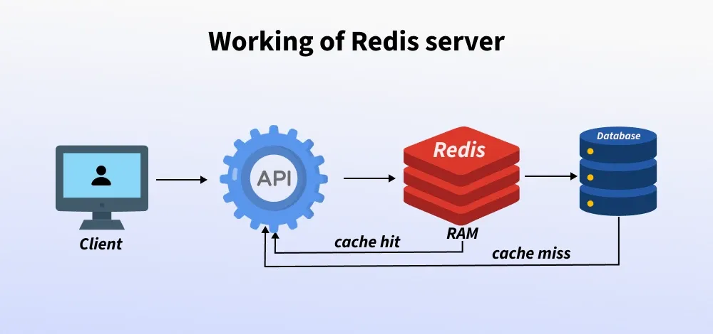
Redis High Level Overview
Backend Server

Slide 3
Why Use Redis?
Ultra-low latency
High throughput
Simple commands
Versatile system
Popular in modern backend architectures

Slide 4
Installation & CLI Basics
Install via Linux/macOS/WSL/Docker
Running the server: redis-server
Connecting to Redis CLI: redis-cli
Essential commands:
PING
SET key value / GET key

Slide 5
Redis Data Types (Overview)
Redis has five essential data types:
Strings
Lists
Sets
Hashes
Sorted Sets (ZSET)

Slide 6
Redis Data Types
Strings:
Stores text, numbers, JSON
Commands: SET / GET / INCR / APPEND
Use for caching, counters, sessions
Lists:
Stores ordered linked list
Commands: LPUSH / RPUSH / LPOP / LRANGE
Use for queues, logs, feeds

Slide 7
Redis Data Types
Sets:
Stores unique unordered values
Commands: SADD / SMEMBERS / SISMEMBER
Use for tags, unique visitors
Hashes:
Stores fields under one key
Commands: HSET / HGET / HGETALL
Use for user profiles, product data

Slide 8
Redis Data Types
Sorted Sets (ZSET):
Stores unique values sorted by score
Commands: ZADD / ZRANGE
Use for leaderboards, ranking, timestamp-sorted events

Slide 9
Key Expiry & TTL
Redis can automatically delete keys after a period
EXPIRE key 60
TTL key
SET key value EX 60
Use for caching & tokens

Slide 10
Persistence (Saving Data to Disk)
Redis stores data in memory, but can persist data using RDB and AOF
RDB snapshotting
Saves data at intervals.
Fast, smaller files.
AOF (Append Only File) logging
Logs every write operation.
Durable and safe.
Hybrid persistence
Modern Redis mixes both for balance.

Slide 11
Redis in Real Applications
API caching, rate limiting
Job queues
Leaderboards
Analytics

Slide 12
Integrating Redis
Node: ioredis / redis
Python: redis-py
Go: go-redis
Java: jedis / lettuce
See Labs for code demo

